Slide 1

PREDICTIVE MAINTENANCE DASHBOARD
TEAM: SNIPERS

Slide 2

OBJECTIVE
To develop a HMI for predictive maintenance of electrical assets aimed at minimizing downtime, optimizing asset performance, and reducing maintenance costs. This will be achieved by utilizing data analytics, and real-time monitoring by focusing on certain parameters to identify potential faults and failures before they occur. The goal is to enhance the reliability and lifespan of electrical assets, improve operational efficiency, and ensure safety and compliance with industry standards.

Slide 3
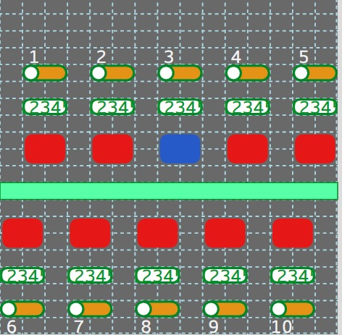
COMPOUND OBJECT 1-FLOW INDICATOR
What is flow indicator?
An indicator that can be used to understand the flow diagram of power/water across various utility.
HOW REUSABLE?
CASE1:
In a building to view power flow for each floor, i.e floor wise power distribution.
CASE2:
In a floor to view power supply for each cubicle.
CASE3:
Can also be used for power flow for each supply point inside a room.
SCALABILITY:
It can be deployed across various horizons like healthcare, university , inside flight control, network management, water management
3 array values are taken:
Toggle value
Value for display
Fault detection

Slide 4
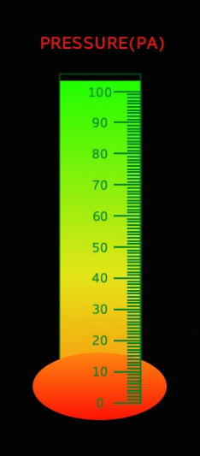
COMPOUND OBJECT-2
CYLINDRICAL SCALE
A cylindrical scale is a scale that can be used for pressure visualization, and liquid level visualization.

Slide 5
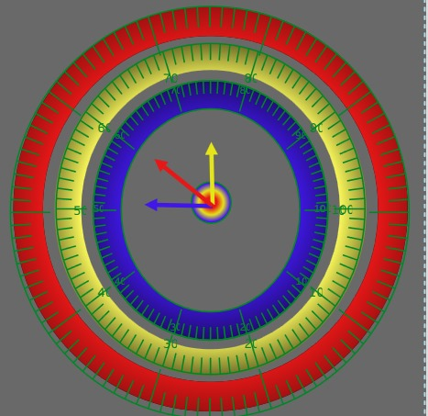
COMPOUND OBJECT-3
COMPOUND OBJECT -3
Space efficient dial, efficient representation of data
It can represent parameter x, parameter y , and parameter y depending upon users need. It can represent pre- established relations if required.

Slide 6
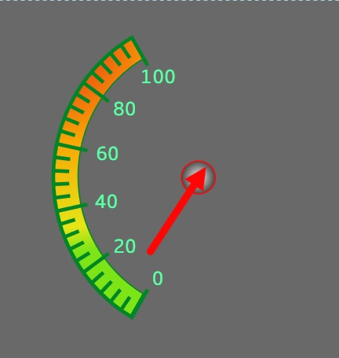
COMPOUND OBJECT-4
TEMPERATURE METER:HAS THE ABILITY TO VISUALIZE THE BODY TEMPERATURE OF ANY BODY.

Slide 7
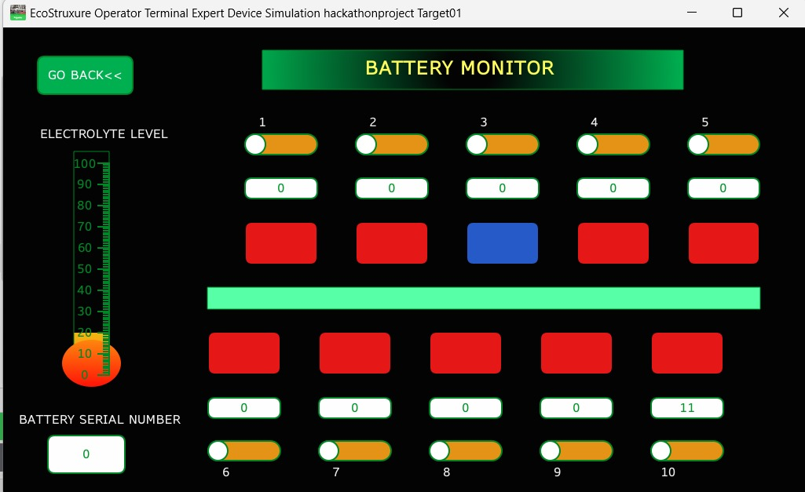
SCREEN1
A Battery Monitor is a screen designed to continuously track the status and performance of a battery/batteries. Here a reusable compound object is used “flow indicator”.
Flow indicator basically gives us insights about which battery is connected to main line, which one is disconnected and which one is faulty.
Data from sensors is processed and indicators represent in Boolean (0,1) format and blue color for no response.
Electrolyte level- Its again represented by a reusable object “vertical meter” where battery details can be accessed with the help of battery serial number.
By providing accurate data on battery conditions, a battery monitor helps users make informed decisions about charging, discharging, and overall battery management, ultimately extending the battery's lifespan and ensuring reliable operation.
Components used- flow indicator , cylindrical meter

Slide 8
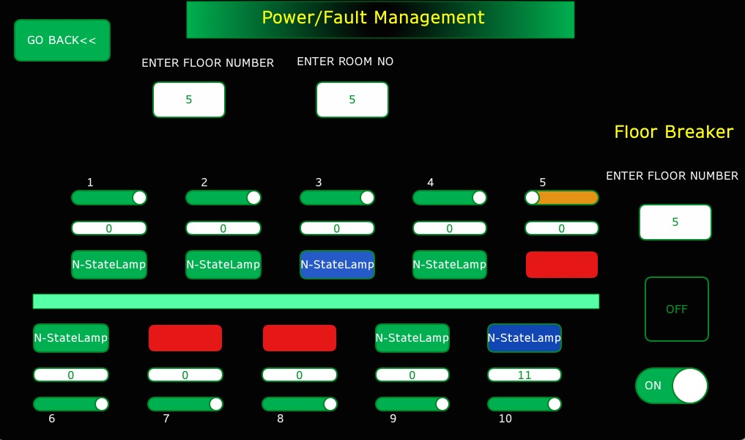
SCREEN2
Floor-Wise Power Distribution: Monitoring total power consumption for each floor to identify high-usage areas, optimize energy allocation, and detect anomalies.
Cubicle-Level Power distribution: Tracking power use for each cubicle on a floor to promote energy efficiency, identify underutilized resources, and reduce waste.
Room-Level Supply Points: Monitoring power consumption at each supply point (e.g., outlets, fixtures) within a room to detect high-power devices, prevent overloads, and enhance safety.
By implementing these monitoring strategies, building managers can improve energy management, reduce costs, and enhance operational efficiency.

Slide 9
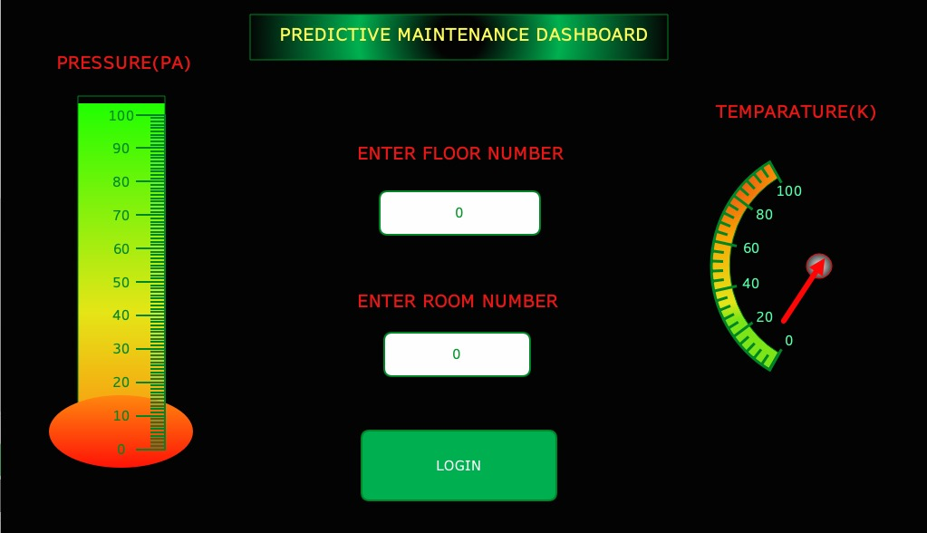
HOME PAGE
This is the homepage for the HMI, here user can view pressure ,room temperature at a particular floor and even at a particular room.
Once you press on login, you get into the first page.

Slide 10
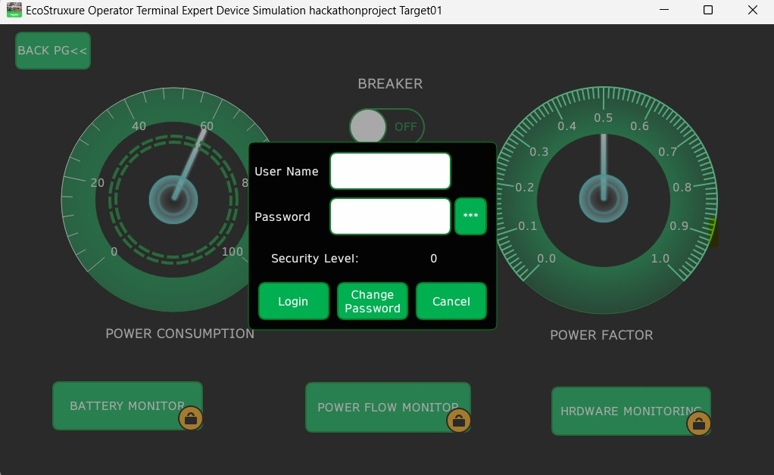
PASSWORD PROTECTED PAGES
POWER FACTOR METER- STAYS LIKE A CONSTANT FROM POWER GENERATION END.
POWER CONSUMPTION METER- VARIES DEPENDING ON LOADS.

Slide 11
SCREEN3
BATTERY/BACKUP MONITOR-
Here a reusable compound object is used “flow indicator”.
Flow indicator basically gives us insights about which battery is connected to main line, which one is disconnected and which one is faulty.
Data from sensors is processed and indicators represent in Boolean (0,1) format and blue color for no response.
Electrolyte level- Its again represented by a reusable object “vertical meter” where battery details can be accessed with the help of battery serial number.

Slide 12
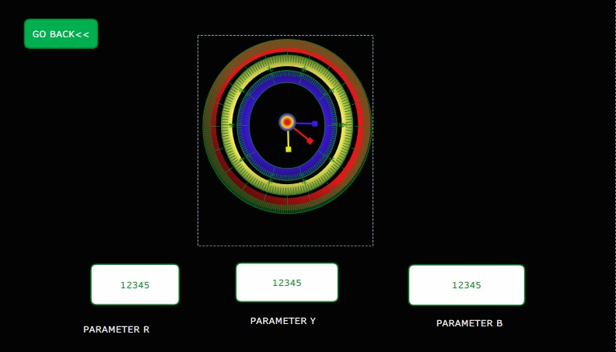
SCREEN4
Any parameter that user wants to visualize , user can just simply use this space efficient visualization tool to see their desired parameters.

Slide 13
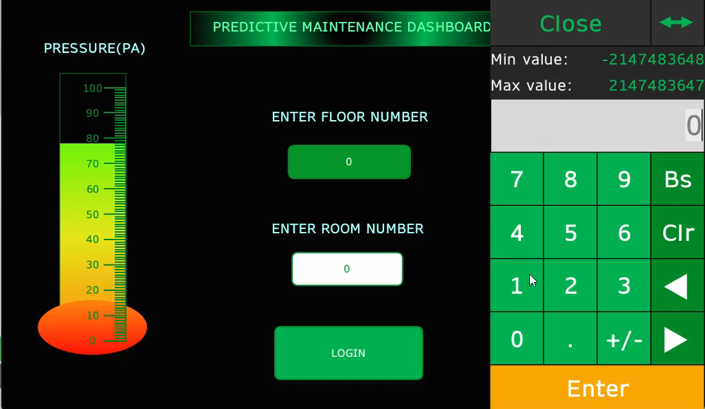
SIMULATION VIDEO

Slide 14
THANK YOU

